Slide 1



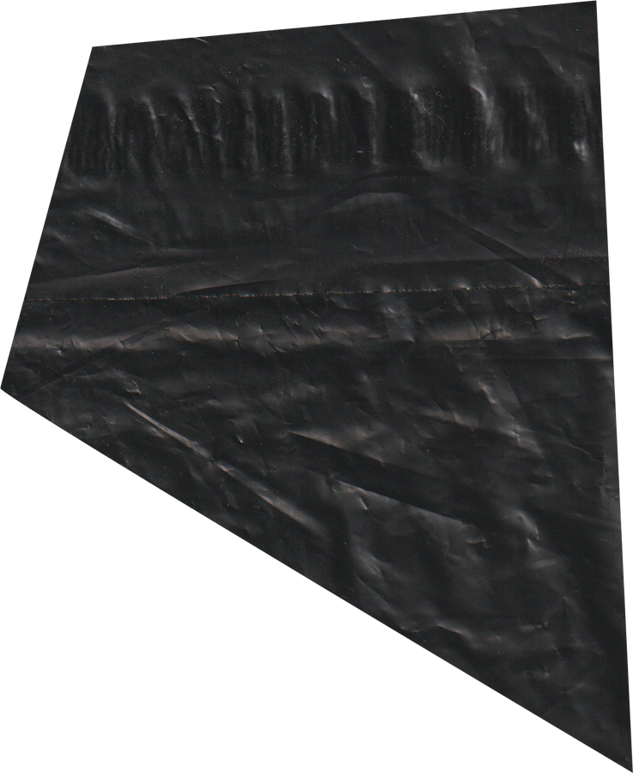
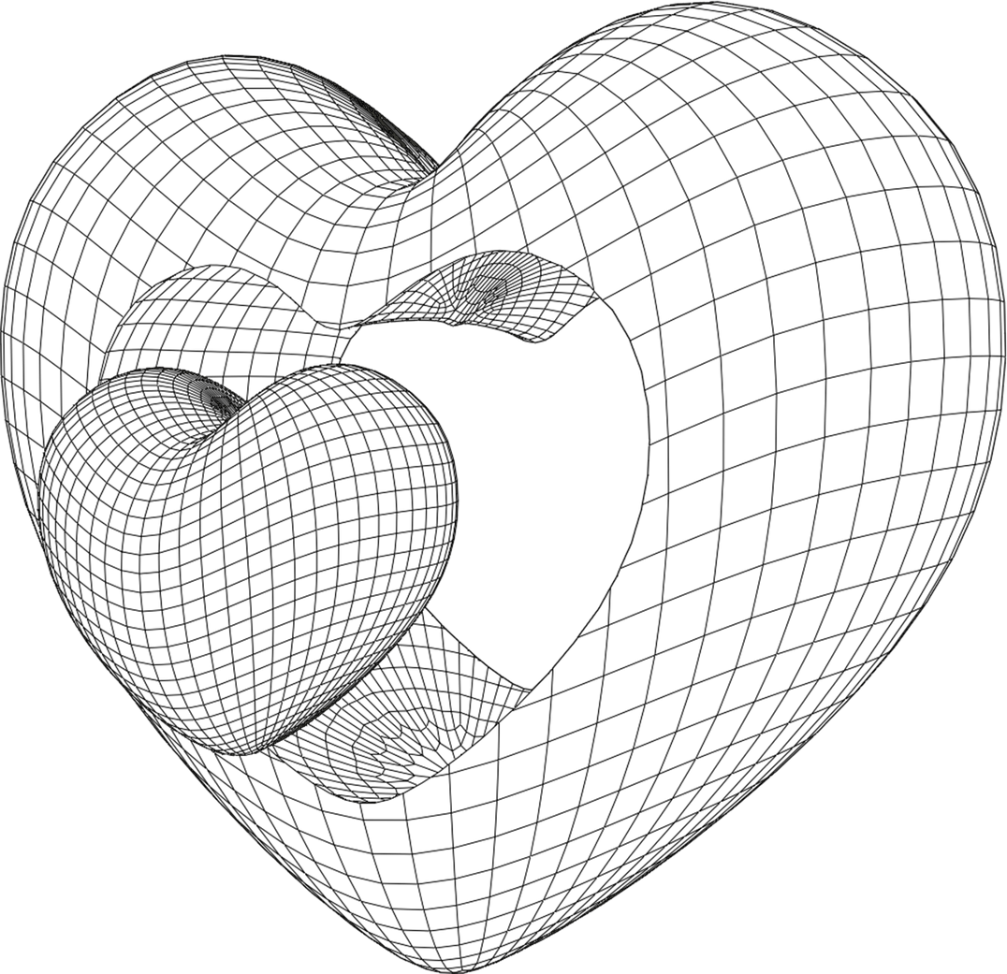

CHEMBIOAI
BOLTZMANN
IIT-BHU BIOCODE BREAKERS
INFOMATRIX
PROTEIN ENGINEERING
Akshansh Dwivedi
Pranav Pawar
Veer Raje
2nd year B.Tech AI & DS
Dwarkadas J. Sanghvi College of Engineering

Slide 2
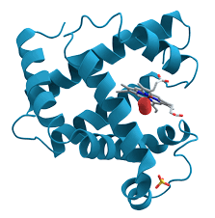
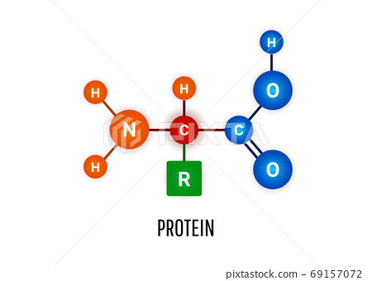
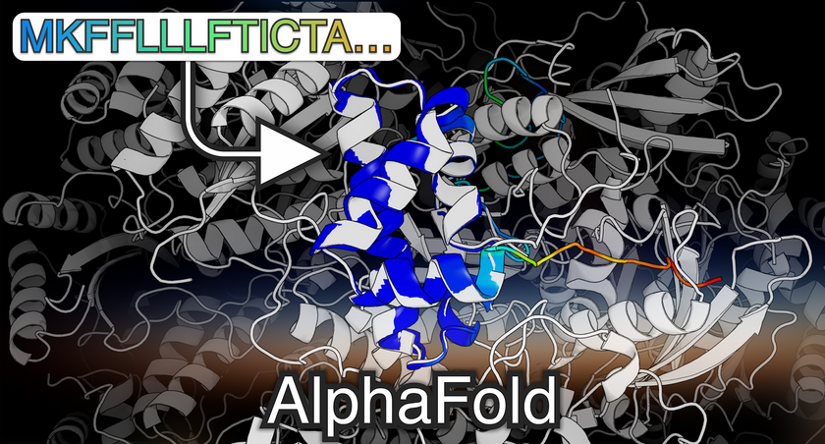

WHY?
Generating protein sequences is crucial for protein design, drug discovery, and understanding protein structure-function relationships. It allows for the creation of novel proteins with desired properties, aids in drug target identification and optimization, and provides insights into protein evolution and synthetic biology applications. This capability drives scientific exploration and advancements in diverse fields such as biotechnology and medicine.

Slide 3
HOW?
1
DATA HANDLING & ANALYSIS
5
OUTPUT EVALUATION
2
APPROACH 1
6
ONGOING RESEARCH
3
ARCHITECTURE
7
APPROACH 2
4
SEQUENCE GENERATION
8
FUTURE PROSPECT

Slide 4
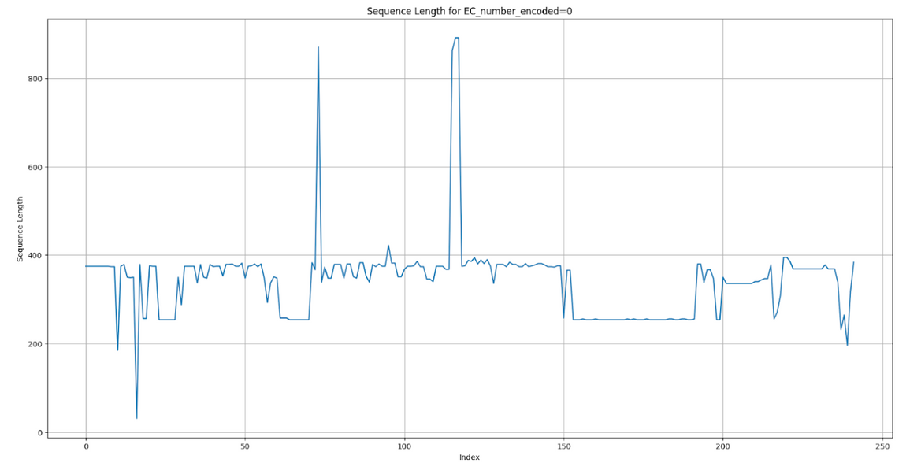
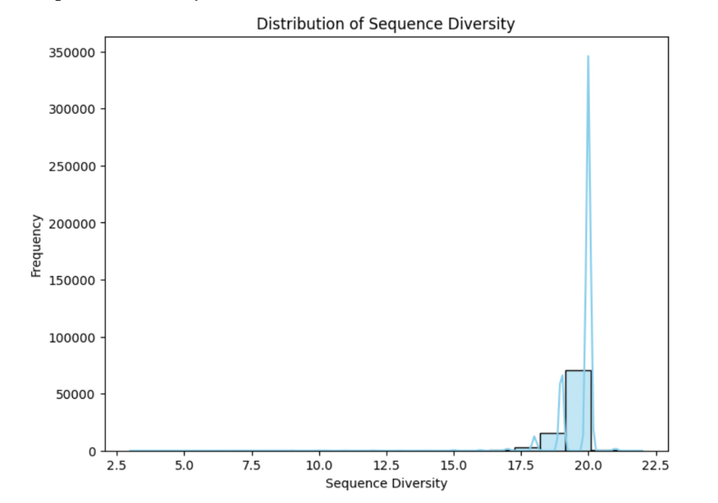
DATA HANDLING AND ANALYSIS
Splitting: ‘name’ split to gene and species for more parameters
Encoding: Used Label encoding on EC_number and ‘species’

Slide 5
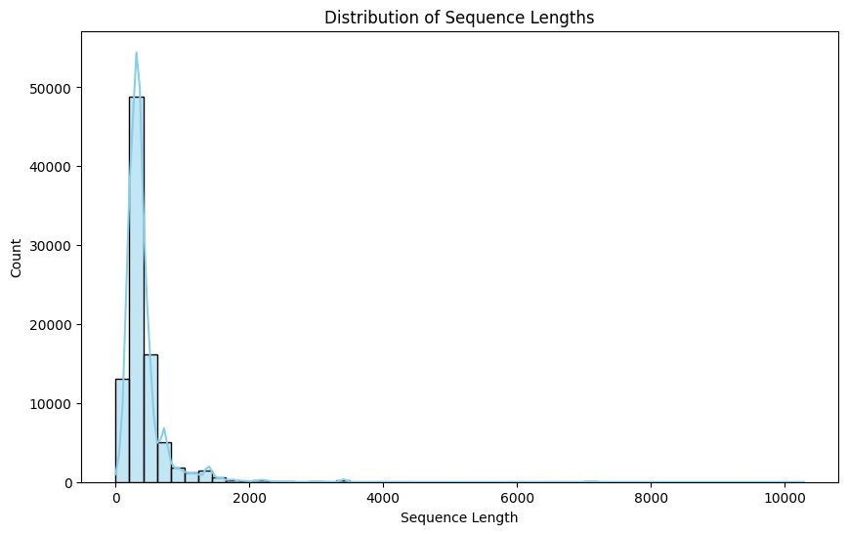
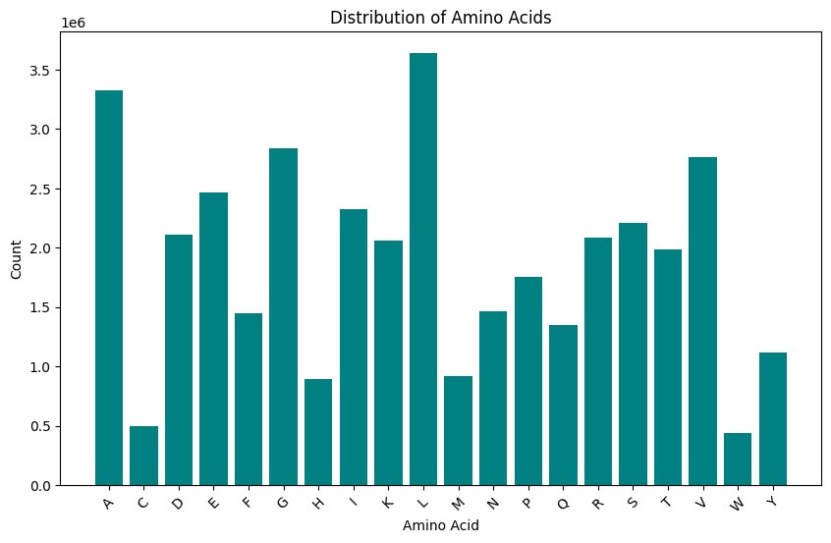
DATA HANDLING AND ANALYSIS
Cleaning: Cleaned rows with protein sequences with invalid amino acids
Sequence Vectorization: One-hot encoding to vectorize ‘sequence’,(later used Tokenization)

Slide 6
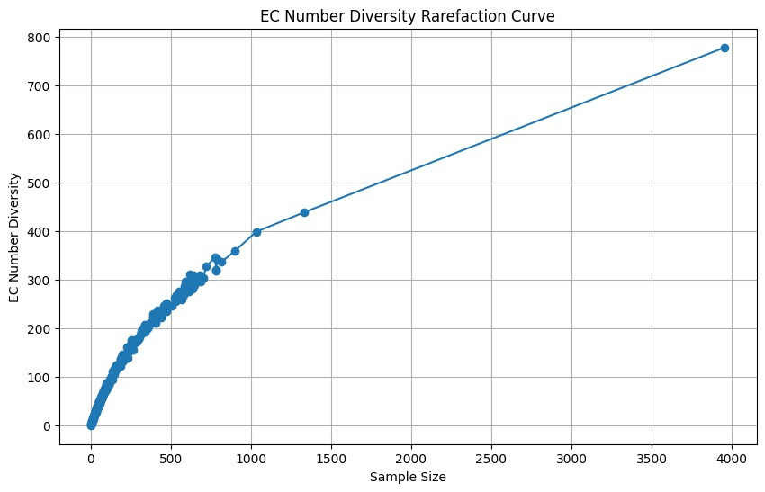
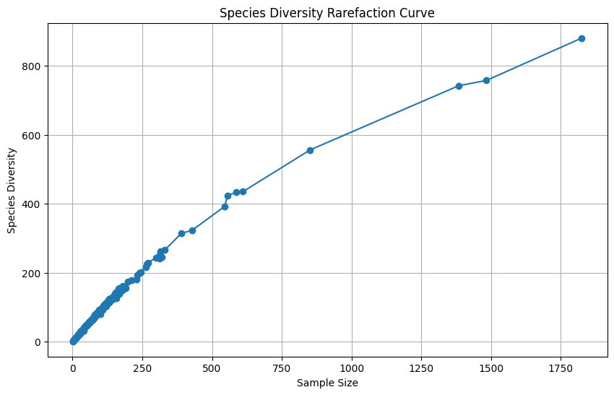
DATA HANDLING AND ANALYSIS
Outlier Detection and Cleaning
Sequence Diversity Distribution
EC Number and Species Diversity Plots

Slide 7
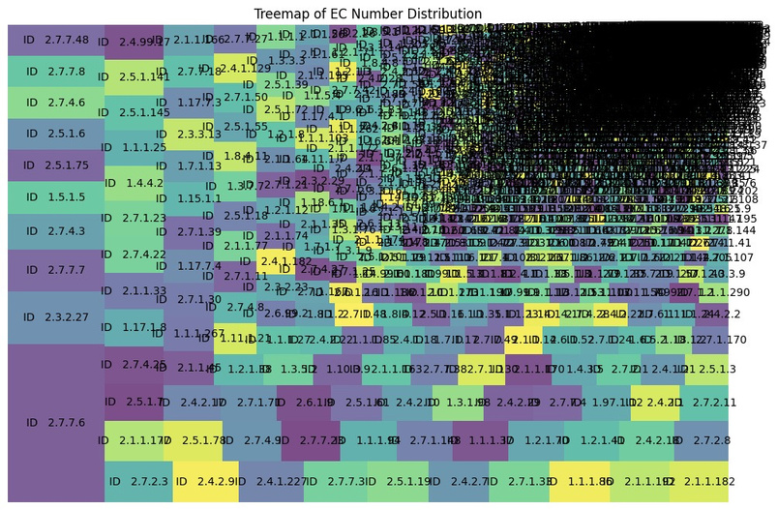
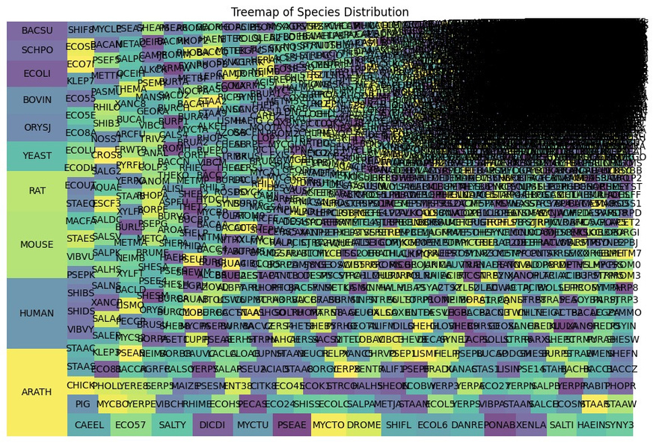
DATA HANDLING AND ANALYSIS
EC_number and species Tree Map
Sequence length distribution
Distribution of amino acids

Slide 8
STEP 1
STEP 2
STEP 3
STEP 4
Input
Embedding
RNN Layer
Hyperparameter Tuning
Model Training
& Evaluate
Making a Deep Learning RNN Model From Scratch
APPROACH 1

Slide 9
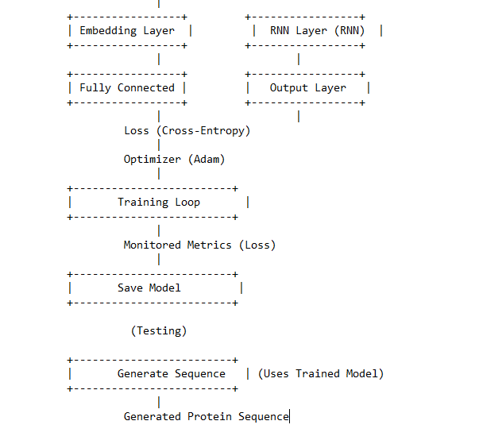
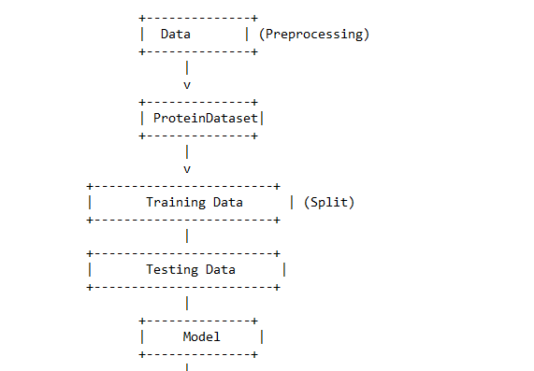
ARCHITECTURE

Slide 10
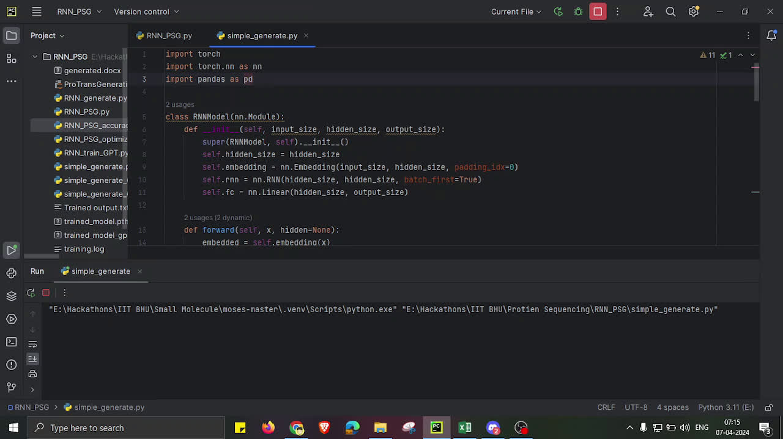
SEQUENCE GENERATION
CHEMBIOAI
BOLTZMANN

Slide 11
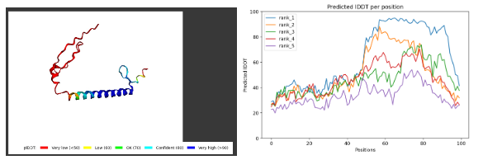
OUTPUT EVALUATION
Using AlphaFold2 to Evaluate Generated Protein Sequences
SEQUENCE
MODEL
pLDDT
pTM
tol
ACGLESNVGETVIPDGE......
ALPHAFOLD2_PTM_MODEL_5_SEED_000:
63.5
0.363
1

Slide 12
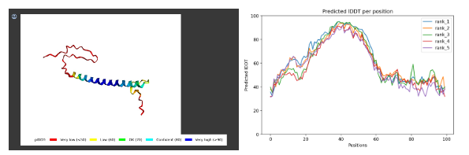
OUTPUT EVALUATION
Using AlphaFold2 to Evaluate Generated Protein Sequences
SEQUENCE
MODEL
pLDDT
pTM
tol
ADVMARPLSSALPFV
......
ALPHAFOLD2_PTM_MODEL_3_SEED_000:
62.8
0.368
0.74

Slide 13
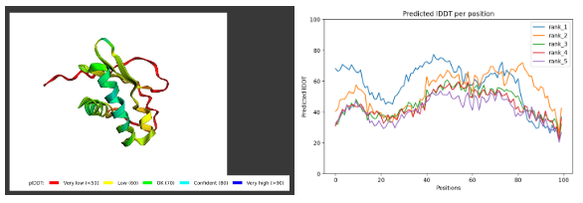
OUTPUT EVALUATION
Using AlphaFold2 to Evaluate Generated Protein Sequences
SEQUENCE
MODEL
pLDDT
pTM
tol
AVADLLSDLFMKELGHI
........
ALPHAFOLD2_PTM_MODEL_3_SEED_000:
57.4
0.458
1.27

Slide 14
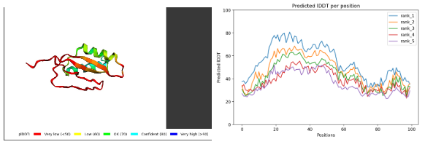
OUTPUT EVALUATION
Using AlphaFold2 to Evaluate Generated Protein Sequences
SEQUENCE
MODEL
pLDDT
pTM
tol
AKTKKNVTMNIELAL
........
ALPHAFOLD2_PTM_MODEL_5_SEED_000:
54.5
0475
1.88

Slide 15
ONGOING RESEARCH
OPTIMIZED RNN
MODEL
Bidirectional LSTM: Model architecture changed to bidirectional LSTM, capturing information from past and future contexts.
Packed Sequence Handling: Sequences sorted by length and packed into a PackedSequence object.
Dynamic Sequence Length Handling: Sequence lengths computed dynamically for each batch, considering only non-padding elements.
Dropout Regularization: Dropout introduced within LSTM layers, randomly dropping connections during training.
RUNNING AND
TRAINED
EPOCH 1,
TRAIN LOSS: 57.58,
VAL LOSS: 0.0015
100X BIGGER
SEQUENCE
GENERATION CODE INCOMPLETE

Slide 16
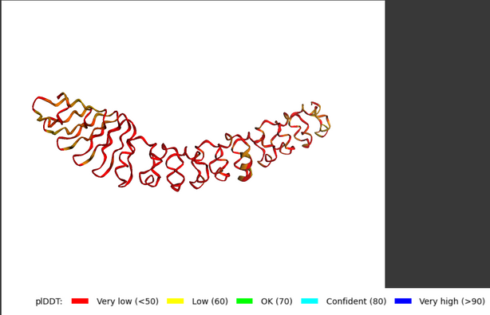
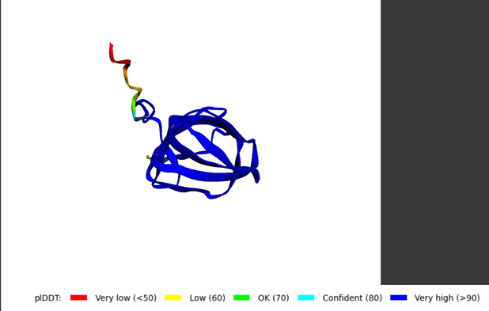
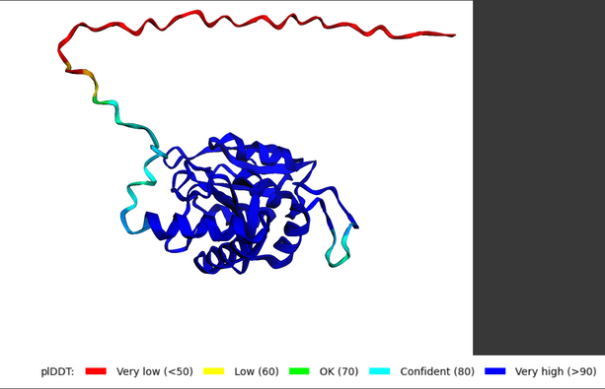
APPROACH 2
USING PRE-TRAINED PROTEIN LANGUAGE MODELS
ROSTLAB/PROT_XLNET
GREATCAPTAINNEMO/PROLLAMA
NFERRUZ/PROTGPT2
Research Paper
Closest to our scratch model
First known Protein LLM
Latest Developments
Least Computational Resources

Slide 17
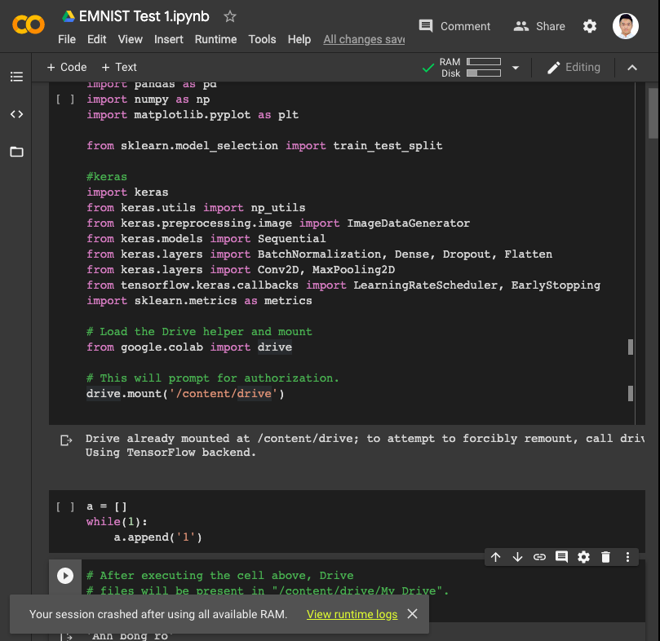


FUTURE
PROSPECT
Generative Adversarial Networks (GANs) for Protein Sequences
Generator Network
Discriminator Network
Ensemble Learning
Reduce Memory Size
Involve AutoML/
NoCode in this sector

Slide 18
CHEMBIOAI
BOLTZMANN
IIT-BHU BIOCODE BREAKERS
THANK YOU
INFOMATRIX
We are open to the QNA Session now

